Slide 1




14,15,21,22 November 2015

Slide 2

Day 4 – Naïve Bayes Classifier
Outlines
Naïve Bayes Learning
Naïve Bayes Testing

Slide 3
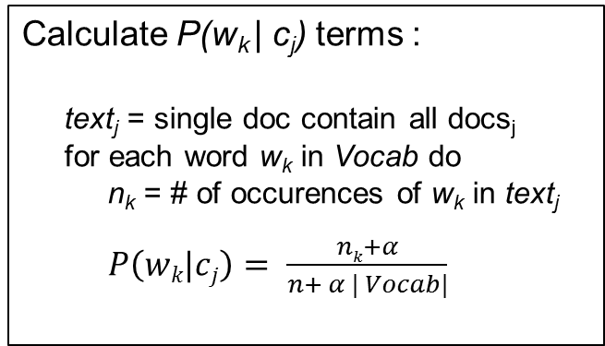
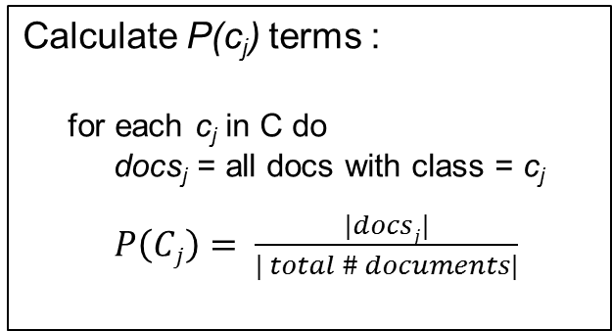
Multinomial Naïve Bayes - Learning
From training corpus, extract vocabulary for each class
Calculate P(c_{j}) terms :
for each c_{j} in C do
docs_{j} = all docs with class = c_{j}
$P\left(Cj\right)= \frac{|docsj|}{| total \# documents|}$
Calculate P(w_{k} | c_{j}) terms :
text_{j} = single doc contain all docs_{j}
for each word w_{k} in Vocab do
n_{k} = # of occurences of w_{k} in text_{j}
$P\left(wk|cj\right)= \frac{nk+α}{n+ α | Vocab|}$

Slide 4
Naïve Bayes Class
from __future__ import division from nltk.metrics import ConfusionMatrix import Preprocessing import openpyxl import xlrd
class NaiveBayes: def __init__(self, fileModel): self.fileModel = fileModel def learning(self, inputFile, featureFile): return
def testing(self, inputFile, outputFile):
return

Slide 5
Naïve Bayes - Learning
def learning(self, inputFile, featureFile): # create file baru untuk result model naive bayes fileResult = openpyxl.Workbook() dataResult = fileResult.active # open data training fileTrain = xlrd.open_workbook(inputFile) dataTrain = fileTrain.sheet_by_index(0) totalNumDocuments = dataTrain.nrows # open data feature fileFeature = xlrd.open_workbook(featureFile) dataFeature = fileFeature.sheet_by_index(0) rowLenFeature = dataFeature.nrows

Slide 6
Naïve Bayes - Learning
label = []
term = []
cls = [] # get term feature and label class in cell dataFeature for i in range(0, rowLenFeature): term.append(dataFeature.cell(i, 0).value) label.append(dataFeature.cell(i, 1).value) # ambil data yg unik pada term dan label (tidak ada yg redundan) labelSet = list(set(label)) termSet = list(set(term)) # set label and pc in xls dataResult.append(['Data Probabilitas']) dataResult.append(['Prob Class'])

Slide 7
Naïve Bayes - Learning
# get p(c)(probability of class) atau (prior of class) terhadap
# persebaran class pada data train yang ada for i in range(0, len(labelSet)): dataResult.cell(row=1, column=i + 2).value = labelSet[i] cls.append([]) cls[i].append(labelSet[i]) cls[i].append(label.count(labelSet[i])) pCj = cls[i][1] / totalNumDocuments # probabilitas of class dataResult.cell(row=2, column=i + 2).value = pCj # masukin ke file baru

Slide 8
Naïve Bayes - Learning
# get p(t|c) (probability of term given class) ata (likelihood of term given class) # di loop untuk setiap termset di cari likelihood terhadap semua class yang ada
for i in range(0, len(termSet)): #loop untuk setiap term dataResult.append([termSet[i]]) # masukin dulu datanya ke file baru
# loop untuk setiap term terhadap setiap class yg ada for j in range(0, len(labelSet)): countTerm = 0 countTermInClass = 0 idx = 1 endLoop = False
# proses mencari term(i) dengan label(j) pada cell dataFeature
while endLoop == False:

Slide 9
Naïve Bayes - Learning
# proses mencari term(i) dengan label(j) pada cell dataFeature
while endLoop == False: if dataFeature.cell(idx, 1).value == labelSet[j]: if dataFeature.cell(idx, 0).value == termSet[i]:
#menghitung berapa banyak term(i) pada label(j) countTerm = countTerm + 1
# menghitung berapa banyak total term pada label(j) countTermInClass = countTermInClass + 1 idx = idx + 1
# kalau bukan cek udah ganti belum labelnya,
# kalau udah stop aja soalnya datanya terurut by label if idx < rowLenFeature: if dataFeature.cell(idx, 1).value != labelSet[j]: endLoop = True else: endLoop = True else: idx = idx + 1

Slide 10
Naïve Bayes - Learning
# menghitung likelihood pTC
pTC = (countTerm + 1) / ((countTermInClass) + len(termSet))
dataResult.cell(row=3+i, column=j+2).value = pTC fileResult.save(self.fileModel) return

Slide 11
Wrap it up
from NaiveBayes import NaiveBayes
import Preprocessing inputData = 'Data Training.xlsx'
preprocessedData = "dataset_preprocessing.xlsx" model = "model_classification.xlsx" print "preprocess file" Preprocessing.preprocessFile(inputData, preprocessedData) nb = NaiveBayes(model) print "start learning" nb.learning(inputData, preprocessedData)

Slide 13
THANK YOU

